Slide 1

AndEngine
Braslavski Natan
Ben Moshe Oshri

Slide 2
Introduction
AndEngine is a popular and "easy" to use 2D game framework for Android.
Currently available in two versions: GLES1 and GLES2.
AndEngine was present in a developer sandbox booth during Google I/O 2012
SplitScreen support, network multiplayer apis
Primarily a Java engine with some C++ that includes x86 native libraries.
NOT cross platform
NO 3D support

Slide 3




Popular games
Bunny Brawler
Bunny Shooter
Constant C
Cow and Pig go Home
Draw and Rite
Fireworks
Greedy Spiders
Etc.

Slide 4




Similar projects
Unity 3D
2D/3D cross platform (iOS, Android, PC)
PhysX physics engine, C#, javascript or Boo scripting language
Multiplayer and network support
Cocos2D
Cross platform (Android, iPhone, Win32) 2D engine
C++ based engine
Full source code
Project Anarchy by Havok
FREE Cross-Platform Engine and Toolkit for Mobile Game Developers
Develop and release titles on iOS, Android and Tizen for free.
Extendible C++ plugin based architecture
GameMaker by YoYo Games
2D Cross platform game engine
support for iOS, Android, HTML5, Mac OS, Windows 8, Ubuntu and Windows Phone 8
A lot of more
https://software.intel.com/en-us/android/blogs/2012/03/13/game-engines-for-android
http://en.wikipedia.org/wiki/List_of_game_engines
http://gamedev.stackexchange.com/questions/19219/is-there-a-free-and-open-source-3d-engine-for-android

Slide 5
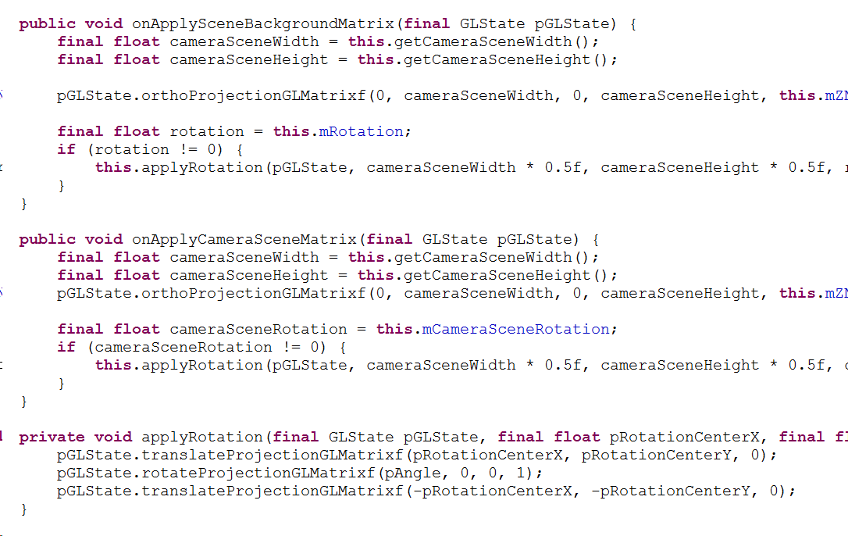
Documentation (1)
Code documentation About 5%

Slide 6

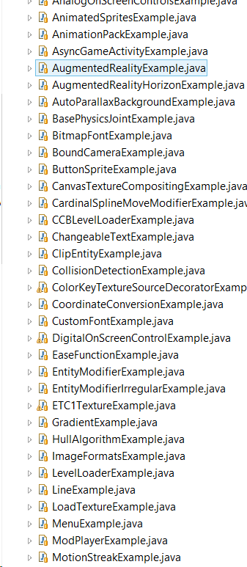
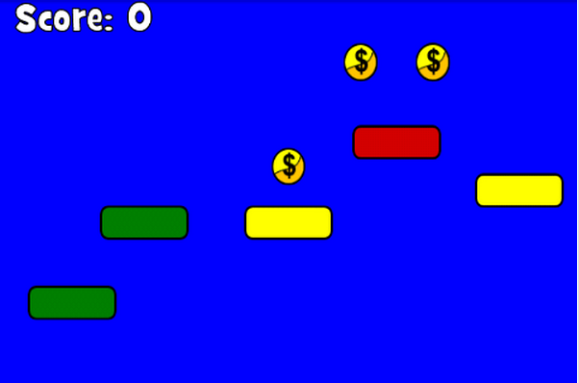
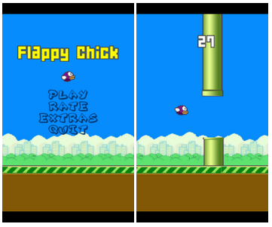

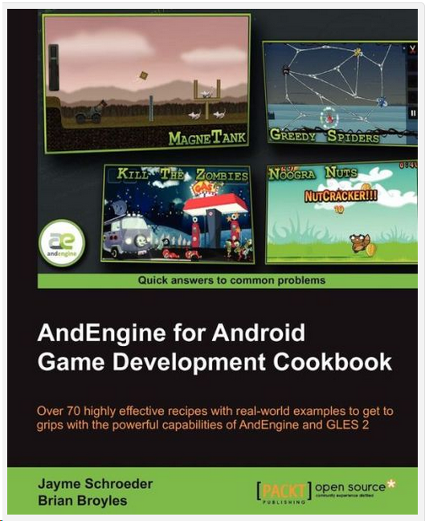
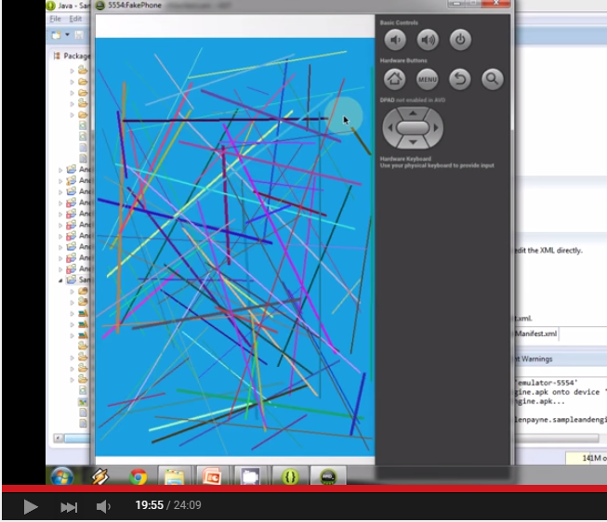
Documentation (2)
Out source documentation
A lot of tutorials
2 Books
A lot of code examples

Slide 7

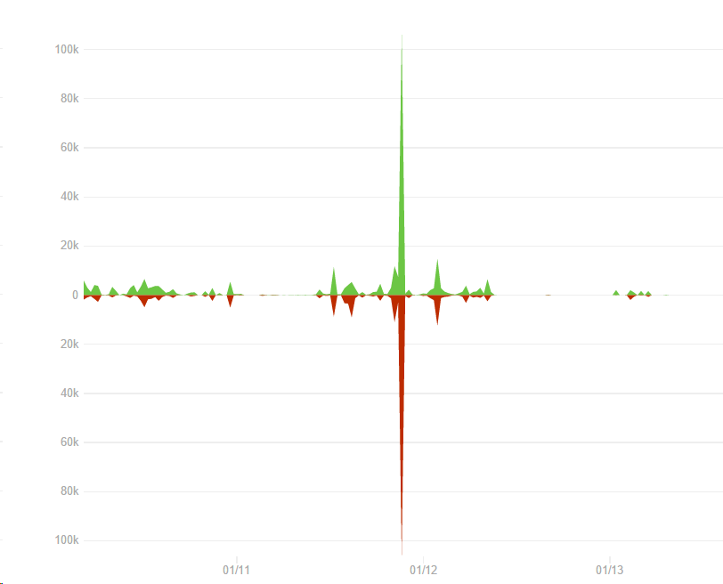
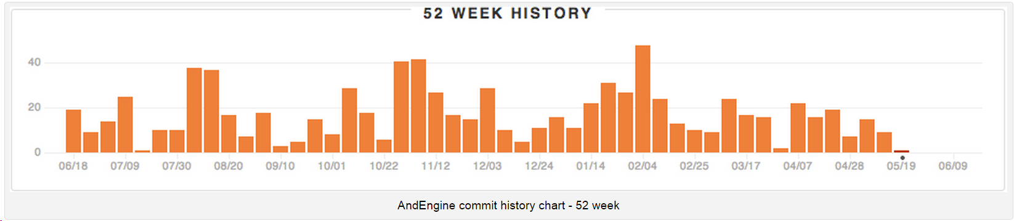
Activity in GitHub

Slide 8
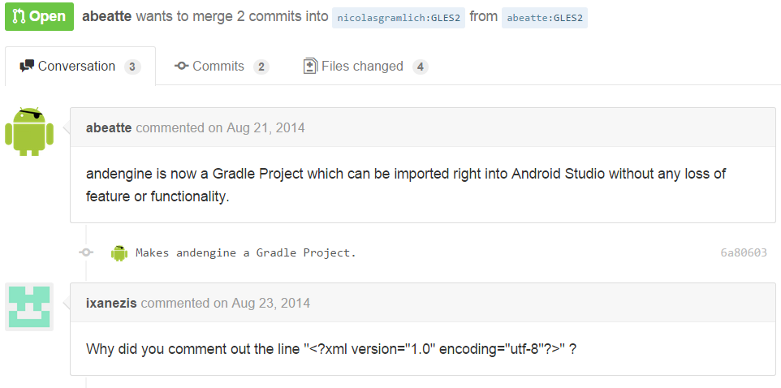
Main millstones (1)
Makes andengine a Gradle Project. #257
Notes:
Gradle is a project automation tool that builds upon the concepts of Apache Ant andApache Maven and introduces a Groovy-based domain-specific language (DSL) instead of the more traditional XML form of declaring the project configuration. Gradle uses adirected acyclic graph ("DAG") to determine the order in which tasks can be run.

Slide 9
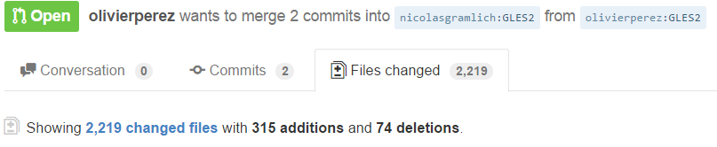
Main millstones (2)
Gather all modules into one single project #262

Slide 10
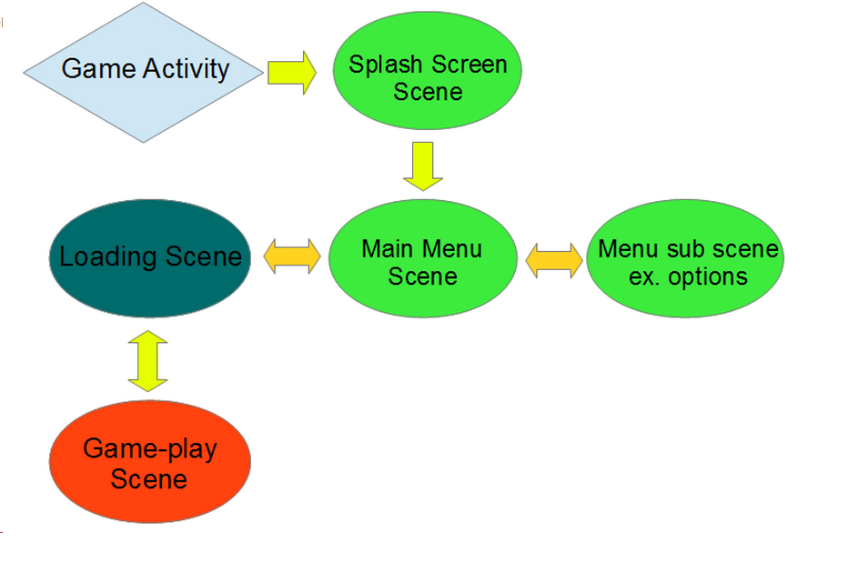
Game Life cycle

Slide 11
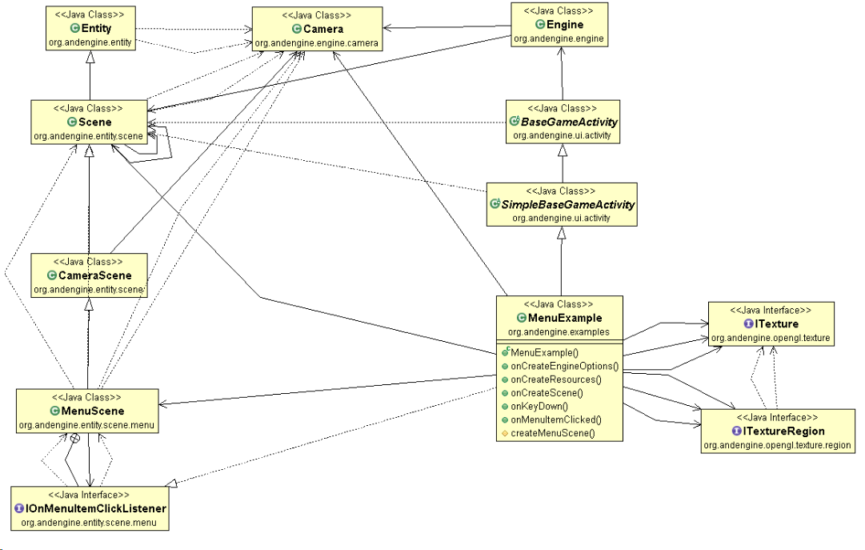

Menu Example

Slide 12
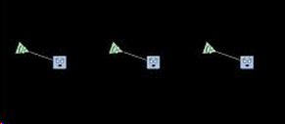
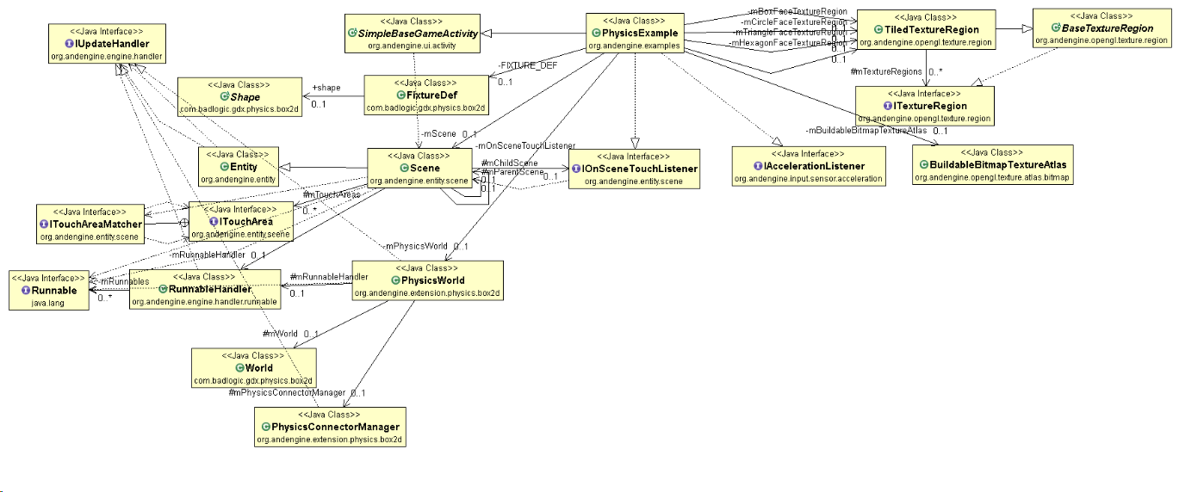
Physics Example

